Slide 1
Broadband Availability Vs Poverty Rates
Mackenzie Taylor 3740102

Slide 2
Hypothesis
To test the correlation between poverty rate and the availability of broadband internet across the US.
H0: There is no significant correlation
Ha: There is a significant correlation

Slide 3
What could this data say
A negative correlation would suggest those in areas of higher poverty have less access to high-speed internet
This could have an effect on people's education or employment with the world being much more dependent on working/learning from home

Slide 4
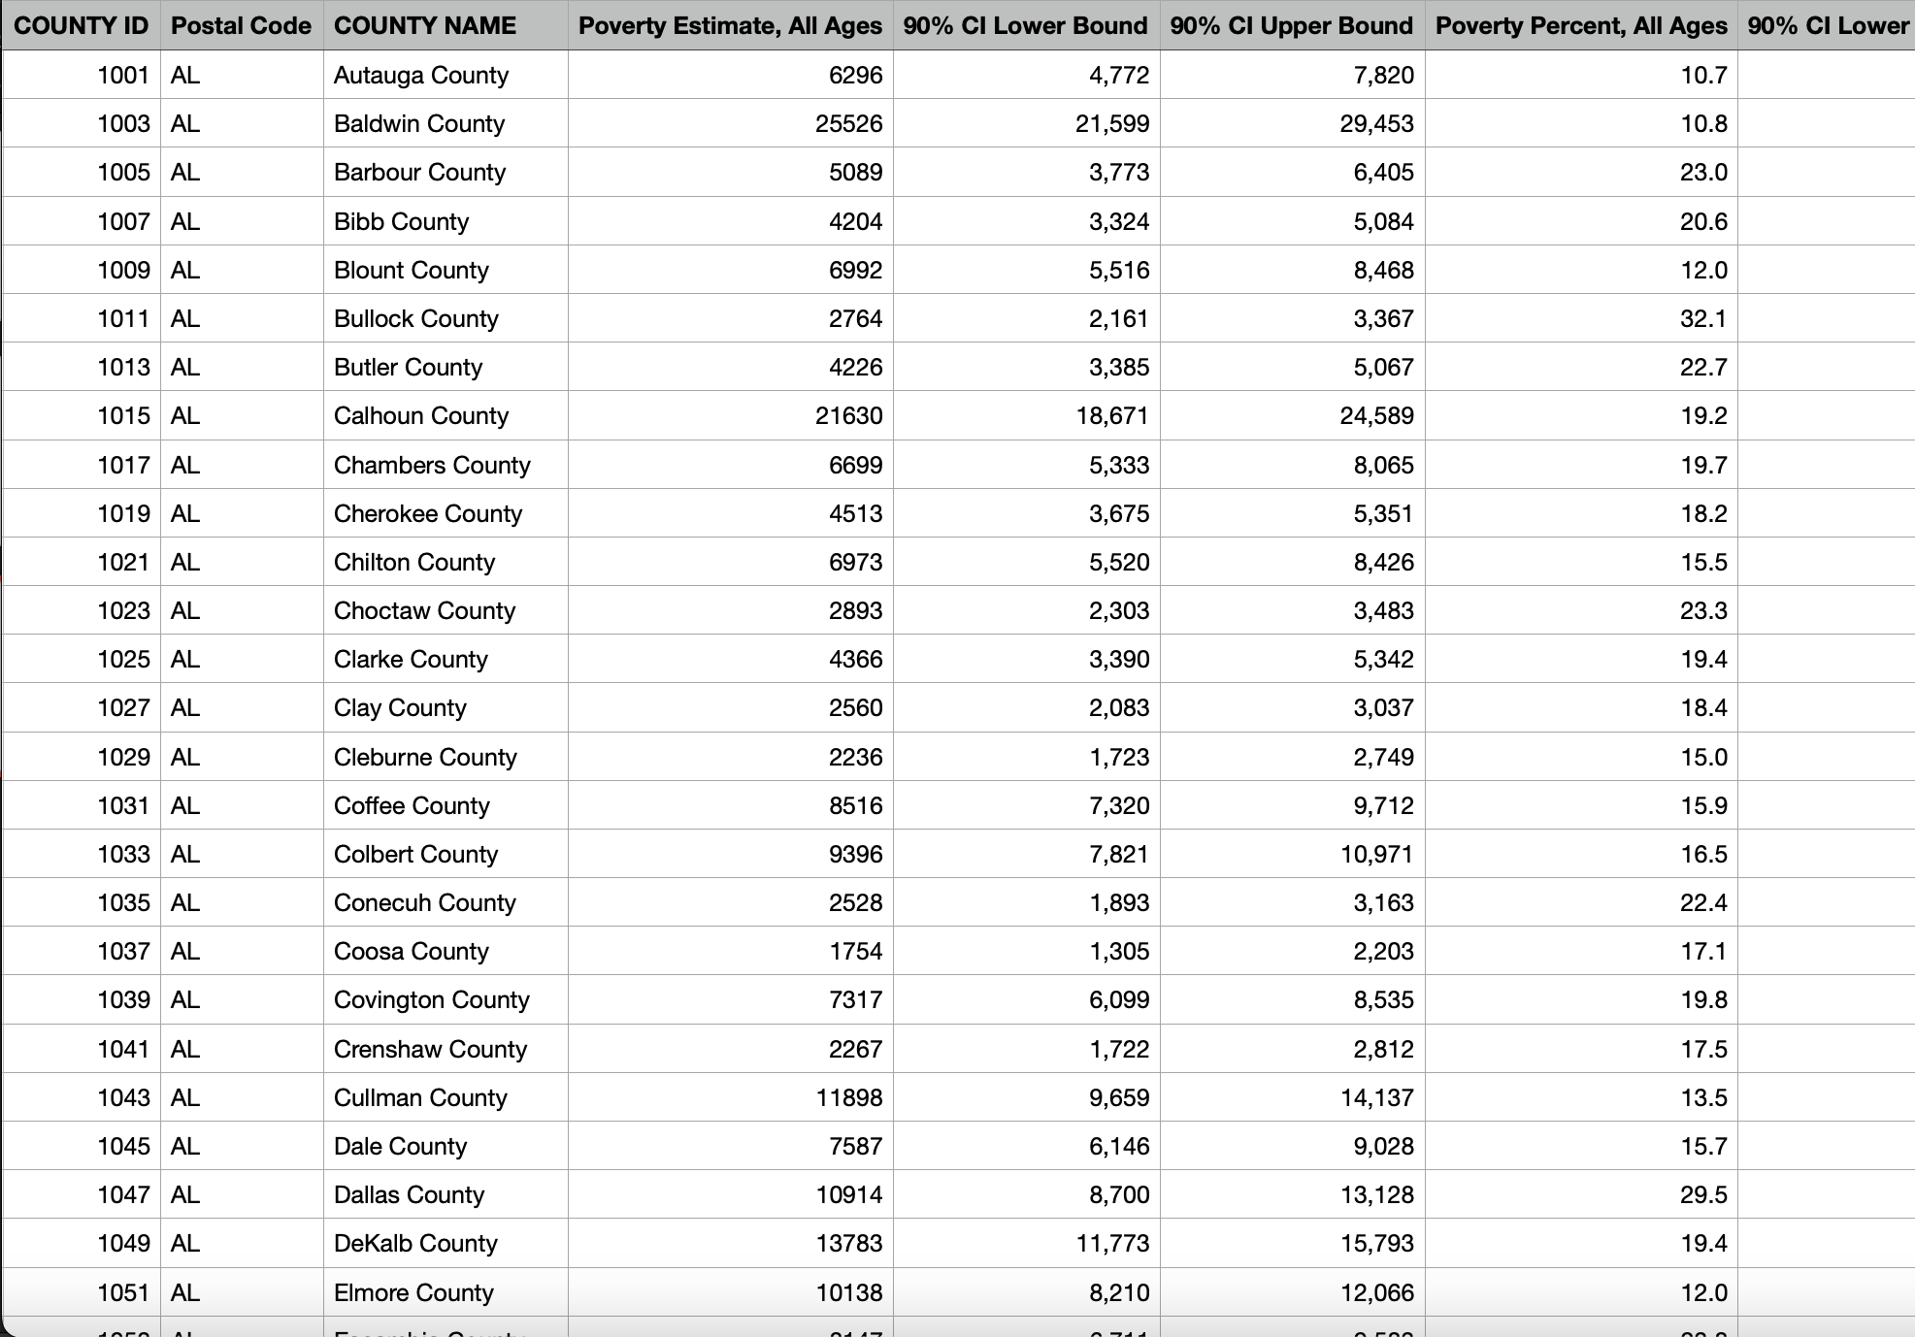
Poverty Rate Data
From United States Census Bureau, 2021
Notes:
Data from all 3143 counties, but only use 3128 after cleaning null values

Slide 5
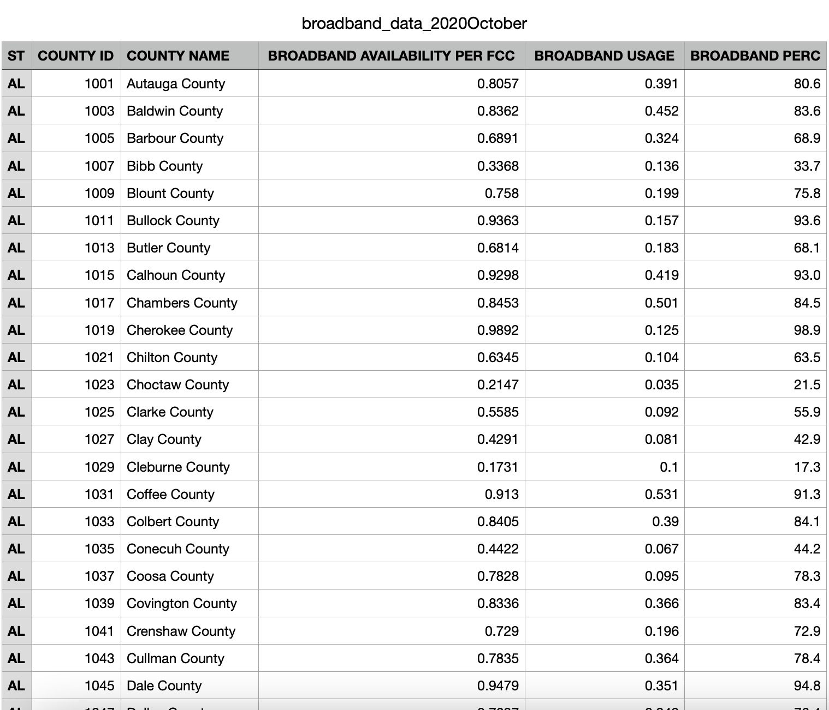
Broadband Availability Data
From Microsoft between 2019 and 2021
Notes:
Percent of people per county with access to fixed terrestrial broadband at speeds of 25 Mbps/3 Mbps as of the end of 2019

Slide 6
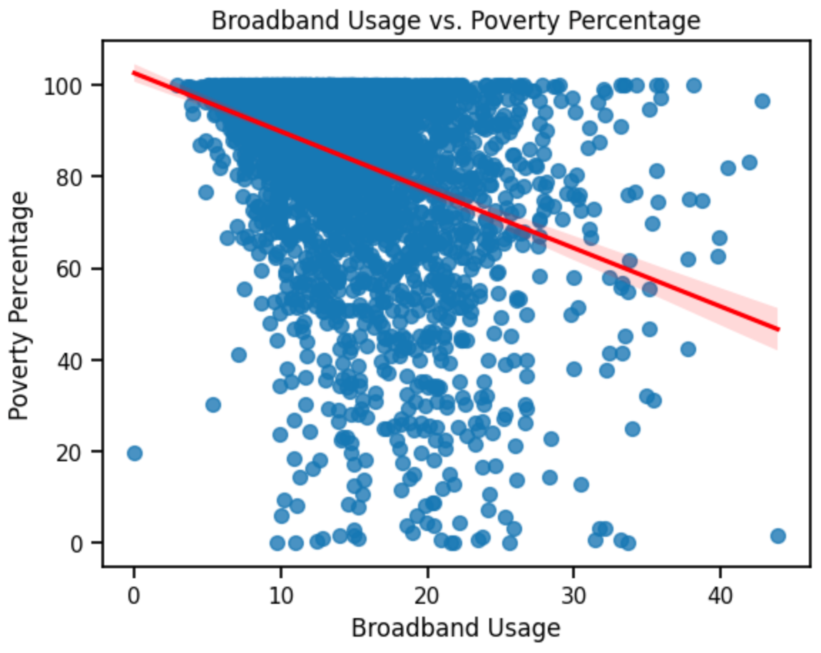
Scatterplot of the data

Slide 7
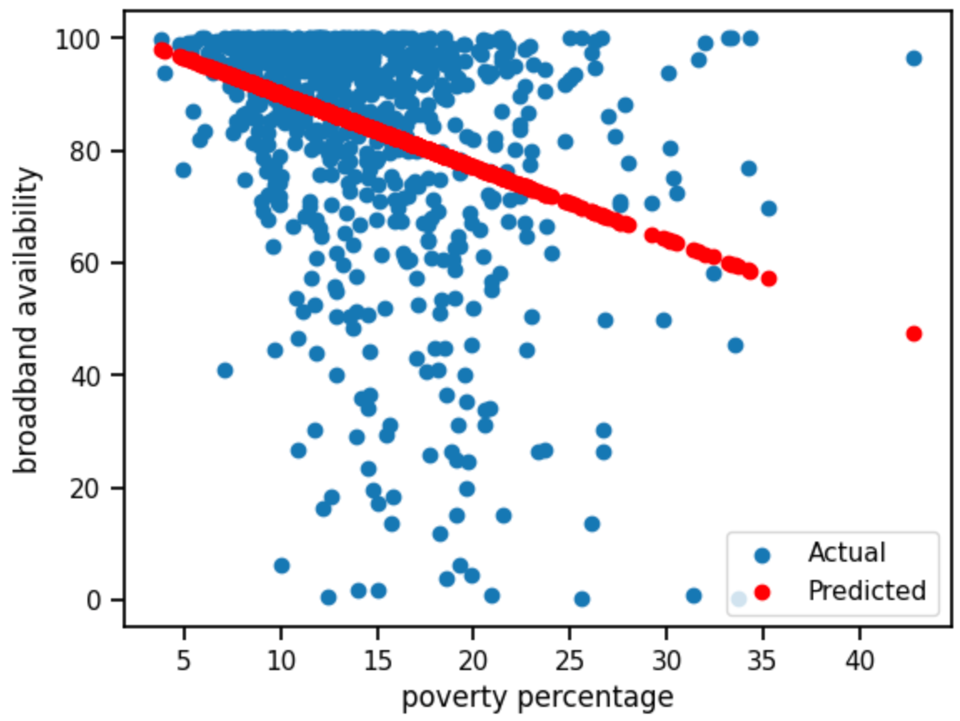
Prediction
Used linear regression to try and predict the availability of broadband internet using poverty percentage as a predictor
Notes:
Mean squared error of around 400 so this tells us the prediction is not accurate

Slide 8

Conclusion
Weak negative correlation suggest those who are poorer have slightly less access to high-speed internet
Using linear regression and poverty rate to predict broadband availability was not viable

